Slide 1
Progress Report 2
By:
Farhan Ijaz
Irtaza Hyder

Slide 2
Summary
Nodes
Publisher Subscriber Model
Server Client Model
Action Model
Rviz and Gazebo

Slide 3
Nodes
Nodes are objects which communicate between each other. They can contain different functions which dictate what parameters are being communicated and how the communication will take place. These help provide modularity by separating different components of the robot.

Slide 4
Topics
Topic refers to exchanging of .msg files between publisher and client nodes.

Slide 5
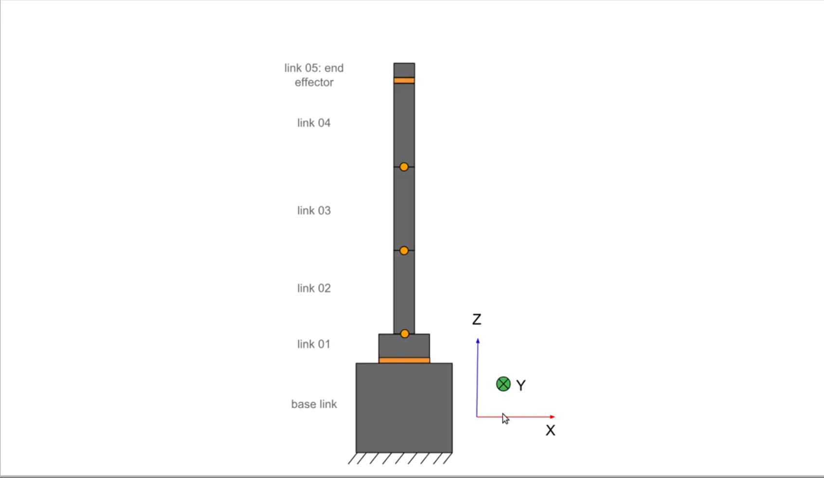
RVIZ
Ideating using RVIZ for ROS1

Slide 6
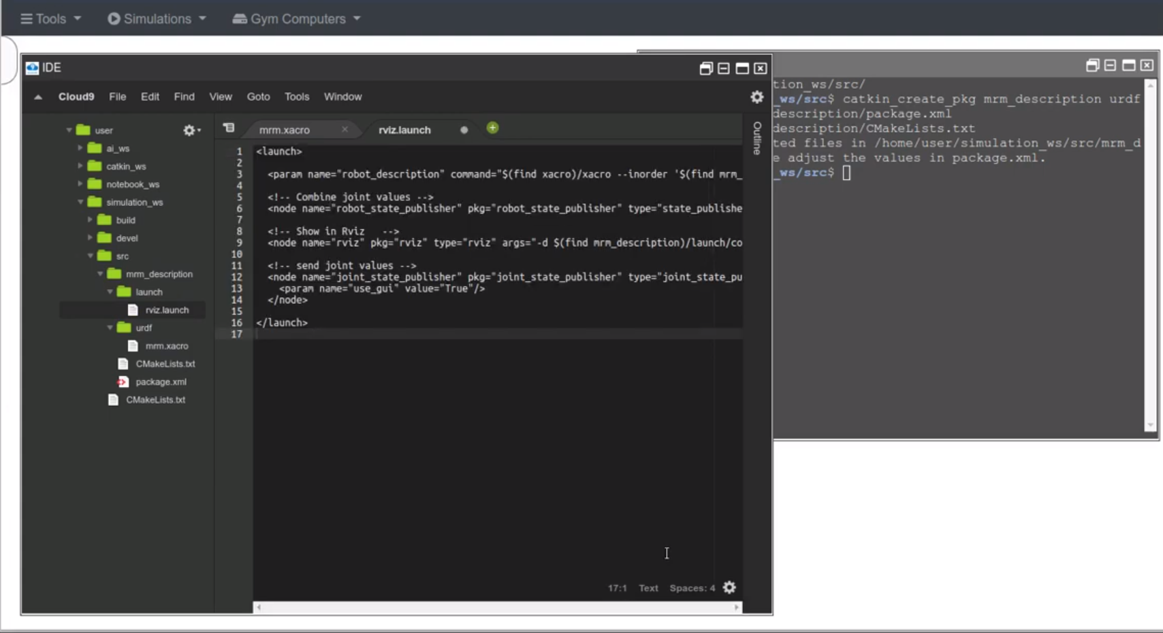

Slide 7
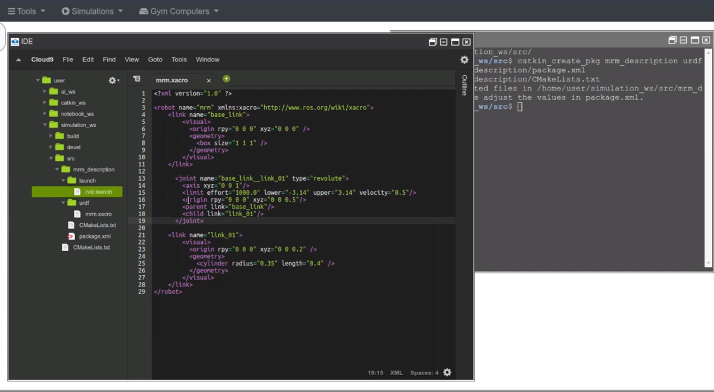

Slide 8
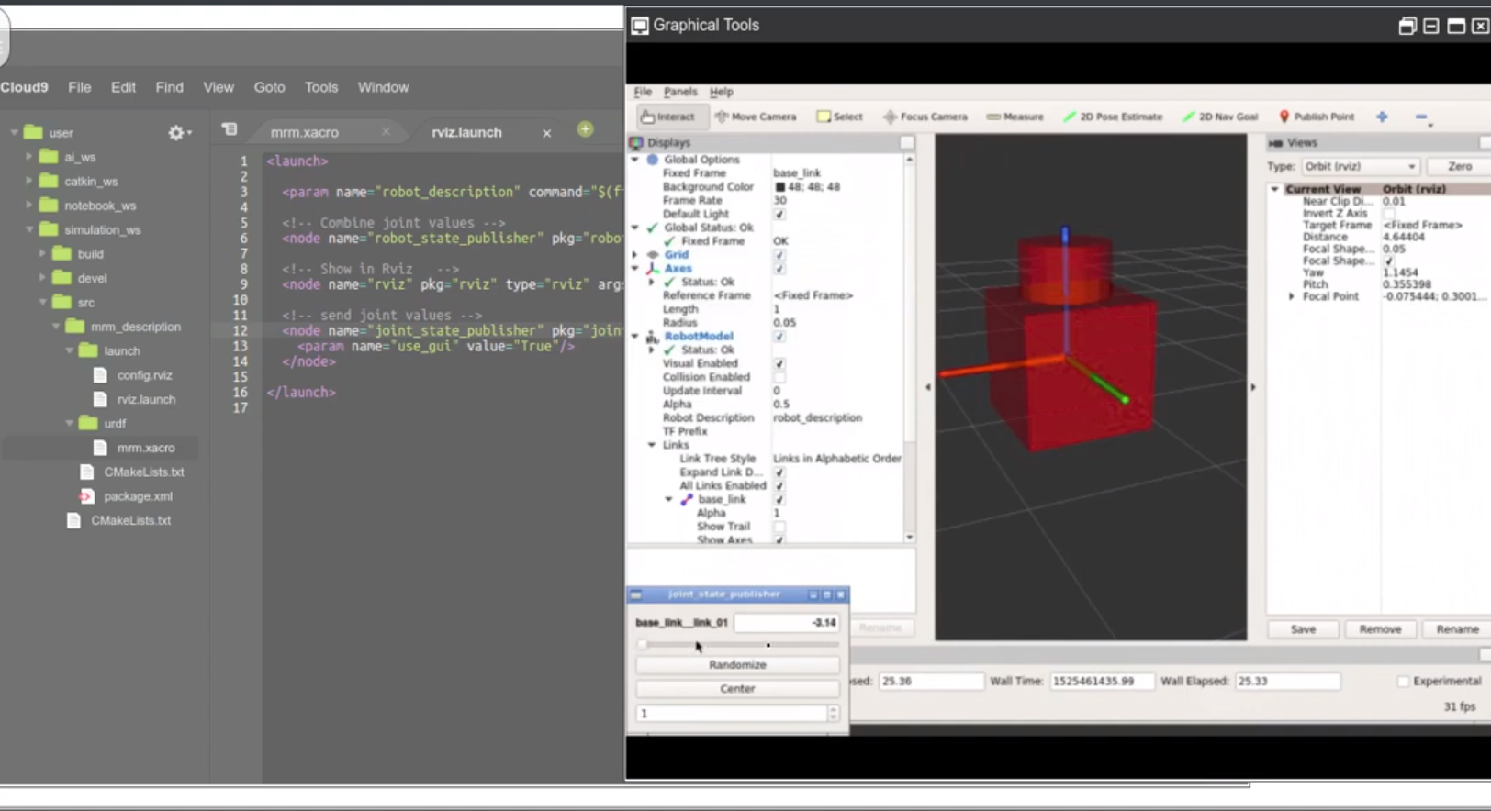

Slide 9
Service
When 2 nodes communicate via client server model, the message is known as a service.
A service is only provided if the client requests it. The request is sent to a server, where the request is processed and then returned. Unlike the publisher-subscriber model, there can only be one server for a specific service.
Format:
Request fields
---
Response fields

Slide 10
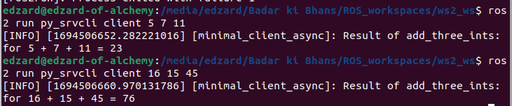
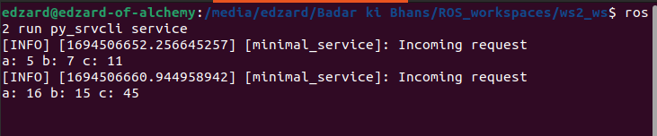
Example
CLIENT
SERVER

Slide 11
Action
Similar to Services, these are mainly used for long running computation.
A service is only provided if the client requests it.
The main difference is that in this model we can get verbose output meanwhile the computation is taking place.
Format:
Request fields
---
Response fields
---
Feedback field

Slide 12
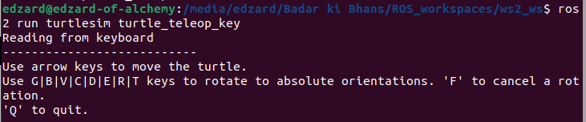
Example

Slide 13
Setting up workspace ROS2
01
03
Creating workspace
Configuration Files
-Go to workspace folder
-Colcon build
-Open new terminal
-Underlay source by <main path?/setup.bash
-Overlay source by install/local_setup.bash
For python packages
-Add dependencies and configure in package.xml
-Add entering point in ‘console_scripts’ and configuration settings in setup.py
For cmake
-Add dependencies and configuration in CMakeList.txt
02
04
Creating packages
Building package
-ros2 pkg create -- build-type ament_<cmake/python> <pkg_name> --license <License> --dependencies <dependencies>
To check if all dependencies present:
-rosdep install --from-paths src --ignore-src -y --skip-keys "fastcdr rti-connext-dds-6.0.1 urdfdom_headers"
Building package
-colcon build

Slide 14
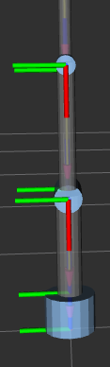
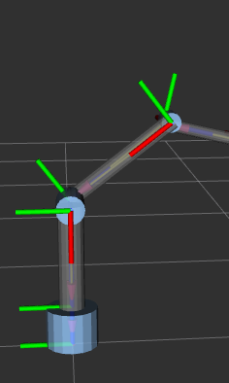
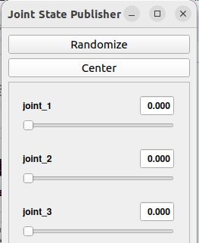
RVIZ 3 Link Robot Simulation
By using joint_state_publisher GUI, we are able to manipulate the 3 Link Robots movement about the blue cylindrical joints.

Slide 15
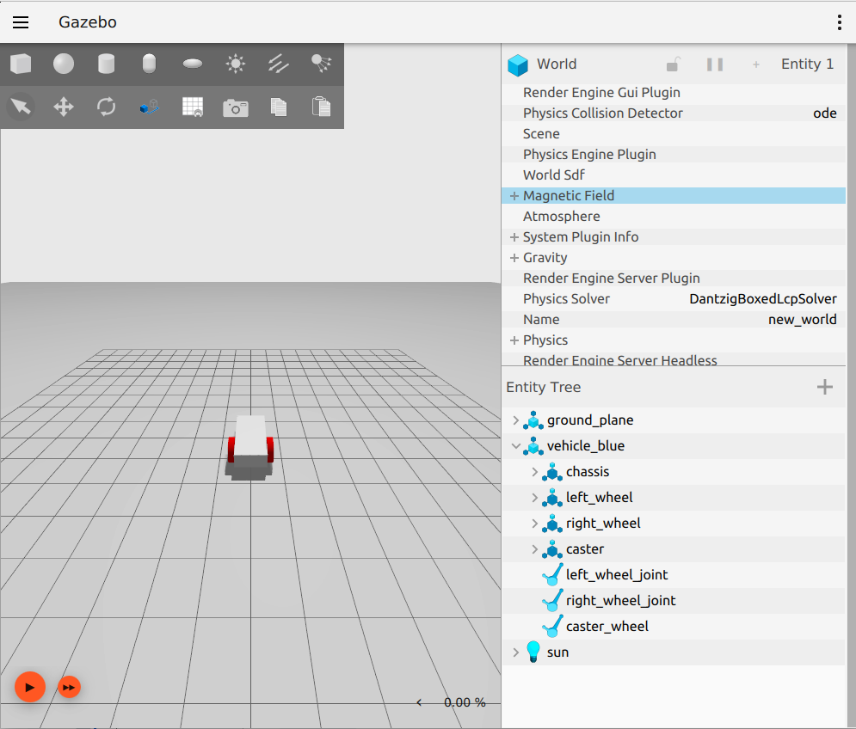
Gazebo
Made a car in gazebo using .sdf file. Baseline car for implementing SLAM on.

Slide 16
SLAM for Mobile Autonomous robot using ROS2(Humble)

Slide 17
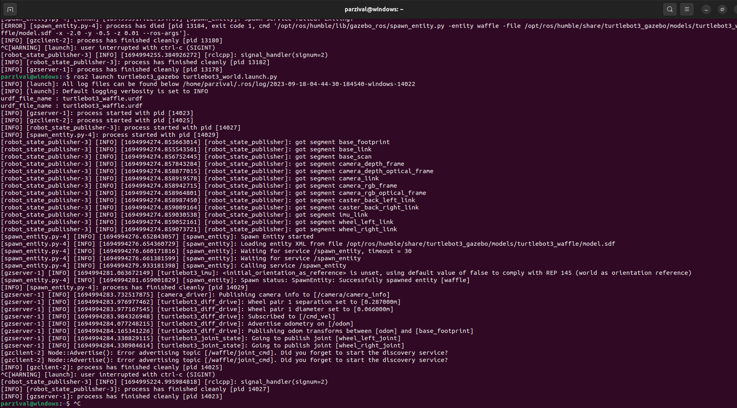
Command Purpose: Launches a simulation environment in ROS 2 for the TurtleBot 3 robot using the Gazebo simulator.
ROS 2: Utilizes the ROS 2 command-line tool to interact with the ROS 2 ecosystem.
turtlebot3_gazebo: Specifies the ROS 2 package responsible for simulating the TurtleBot 3 robot in Gazebo.
turtlebot3_world.launch.py: The launch file that manages the setup of the Gazebo simulation. This Python-based file configures the robot model and the simulation environment.

Slide 18
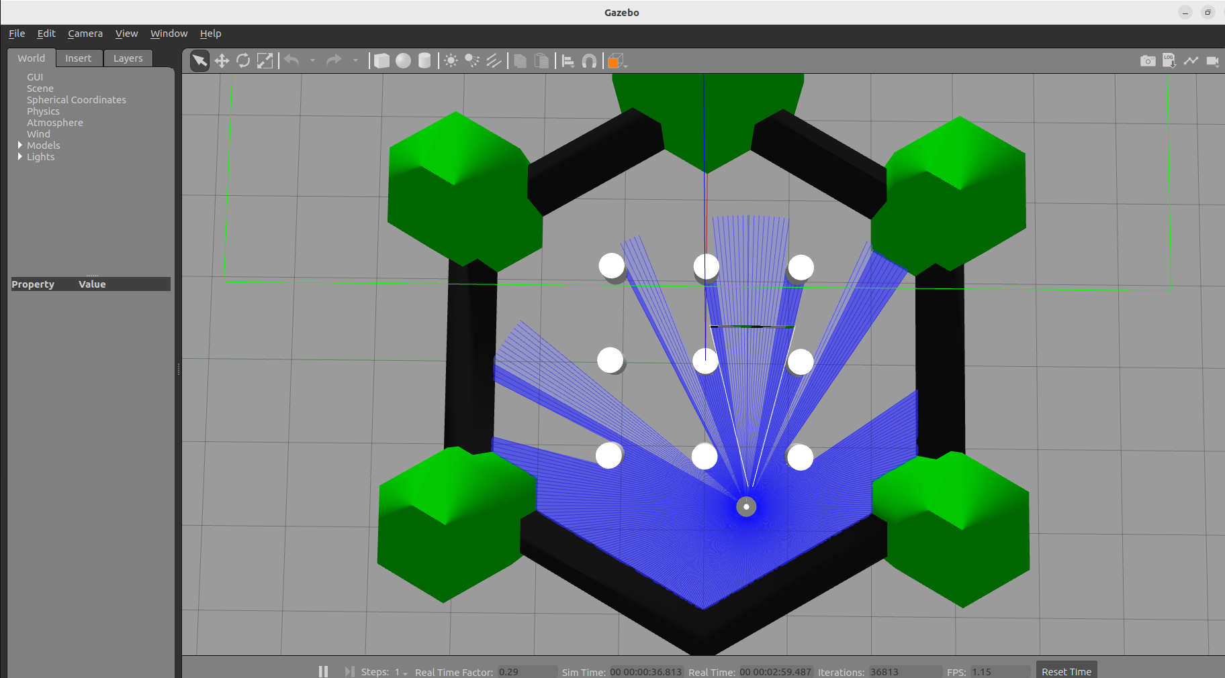
Visual Representation: The Gazebo simulator provides a visual representation of the robot and its surroundings based on the world configuration.
Debugging and Testing: The integration of the command and Gazebo world provides a critical platform for debugging and testing robot applications. You can run experiments, validate code, and identify issues in a controlled and repeatable virtual environment.
Training and Learning: Gazebo's visual interface allows for easy observation and learning about how the robot behaves in different scenarios. This is especially important for students and researchers studying robotics.

Slide 19
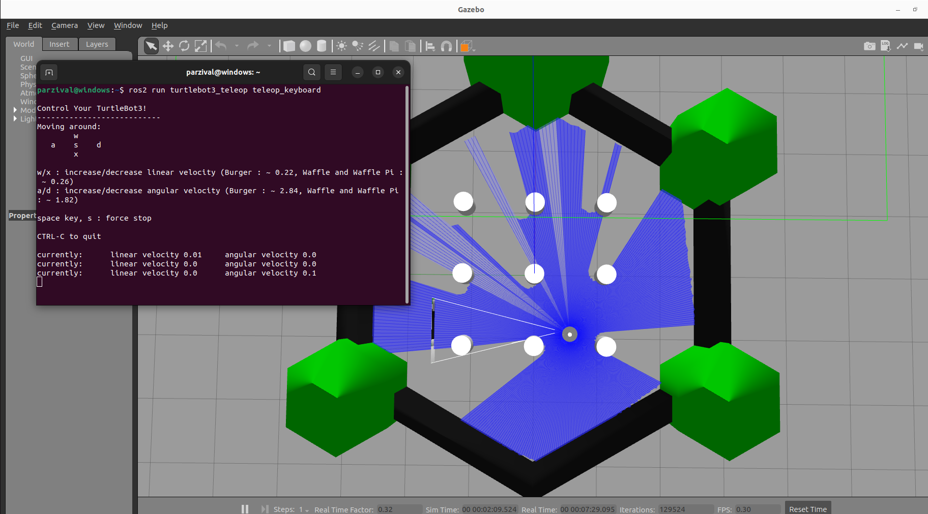
Robot Interaction: In the Gazebo window that opens, you can interact with the simulated TurtleBot 3 robot. This includes teleoperating the robot using a keyboard or controller, observing its sensor data, and testing various robot behaviors.
Realistic Physics: Gazebo simulates realistic physics, allowing you to observe how the robot moves, reacts to sensor inputs, and interacts with the environment. This is valuable for testing and tuning control algorithms.

Slide 20
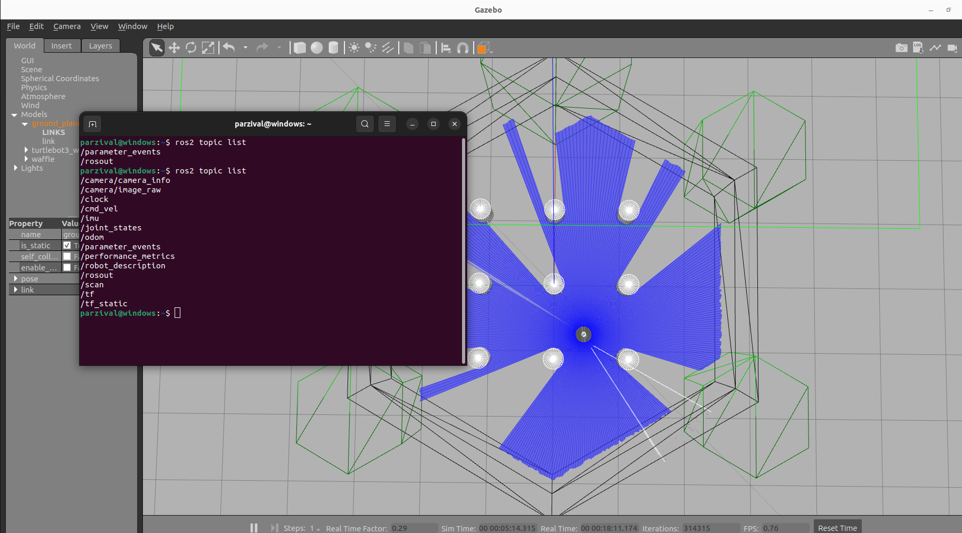
Command Purpose: ros2 topic list is a diagnostic command that provides a list of all currently active ROS 2 topics in the system.
Topic Names: The output of this command will display a list of topic names that are currently available for communication within the ROS 2 environment.
Topic Types: Alongside the topic names, ros2 topic list also shows the data types associated with each topic. This information helps users understand the kind of data being exchanged on a particular topic.
Topic Publishing and Subscribing: ROS 2 nodes can publish messages on topics, and other nodes can subscribe to these topics to receive and process the messages. The topics listed by this command are essential for understanding how nodes communicate.

Slide 21
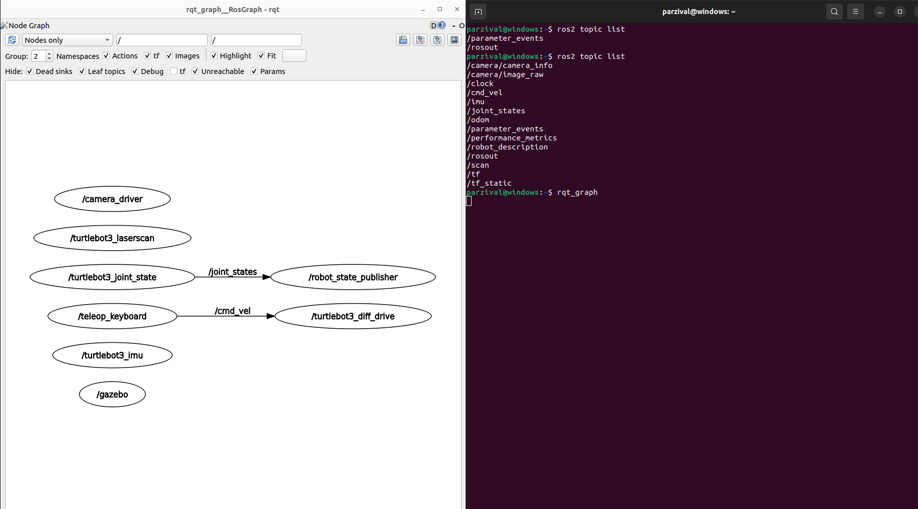
Visualization of Node and Topic Relationships: rqt_graph provides a graphical representation of how nodes in a ROS system are connected through topics. Nodes are represented as rectangular boxes, and topics are represented as arrows connecting these nodes. This visualization helps users understand the flow of data and communication within the ROS system.
Dynamic and Real-Time: One of the key strengths of rqt_graph is its ability to dynamically update in real-time. As nodes are created, destroyed, or modified in the ROS system, the graph is automatically updated to reflect these changes.
Debugging and Troubleshooting: rqt_graph is an essential tool for debugging and troubleshooting ROS applications. It allows users to quickly identify issues such as missing connections between nodes, unexpected data flows, and potential bottlenecks in the communication network. This is particularly helpful in complex robotic systems where multiple nodes interact.

Slide 22
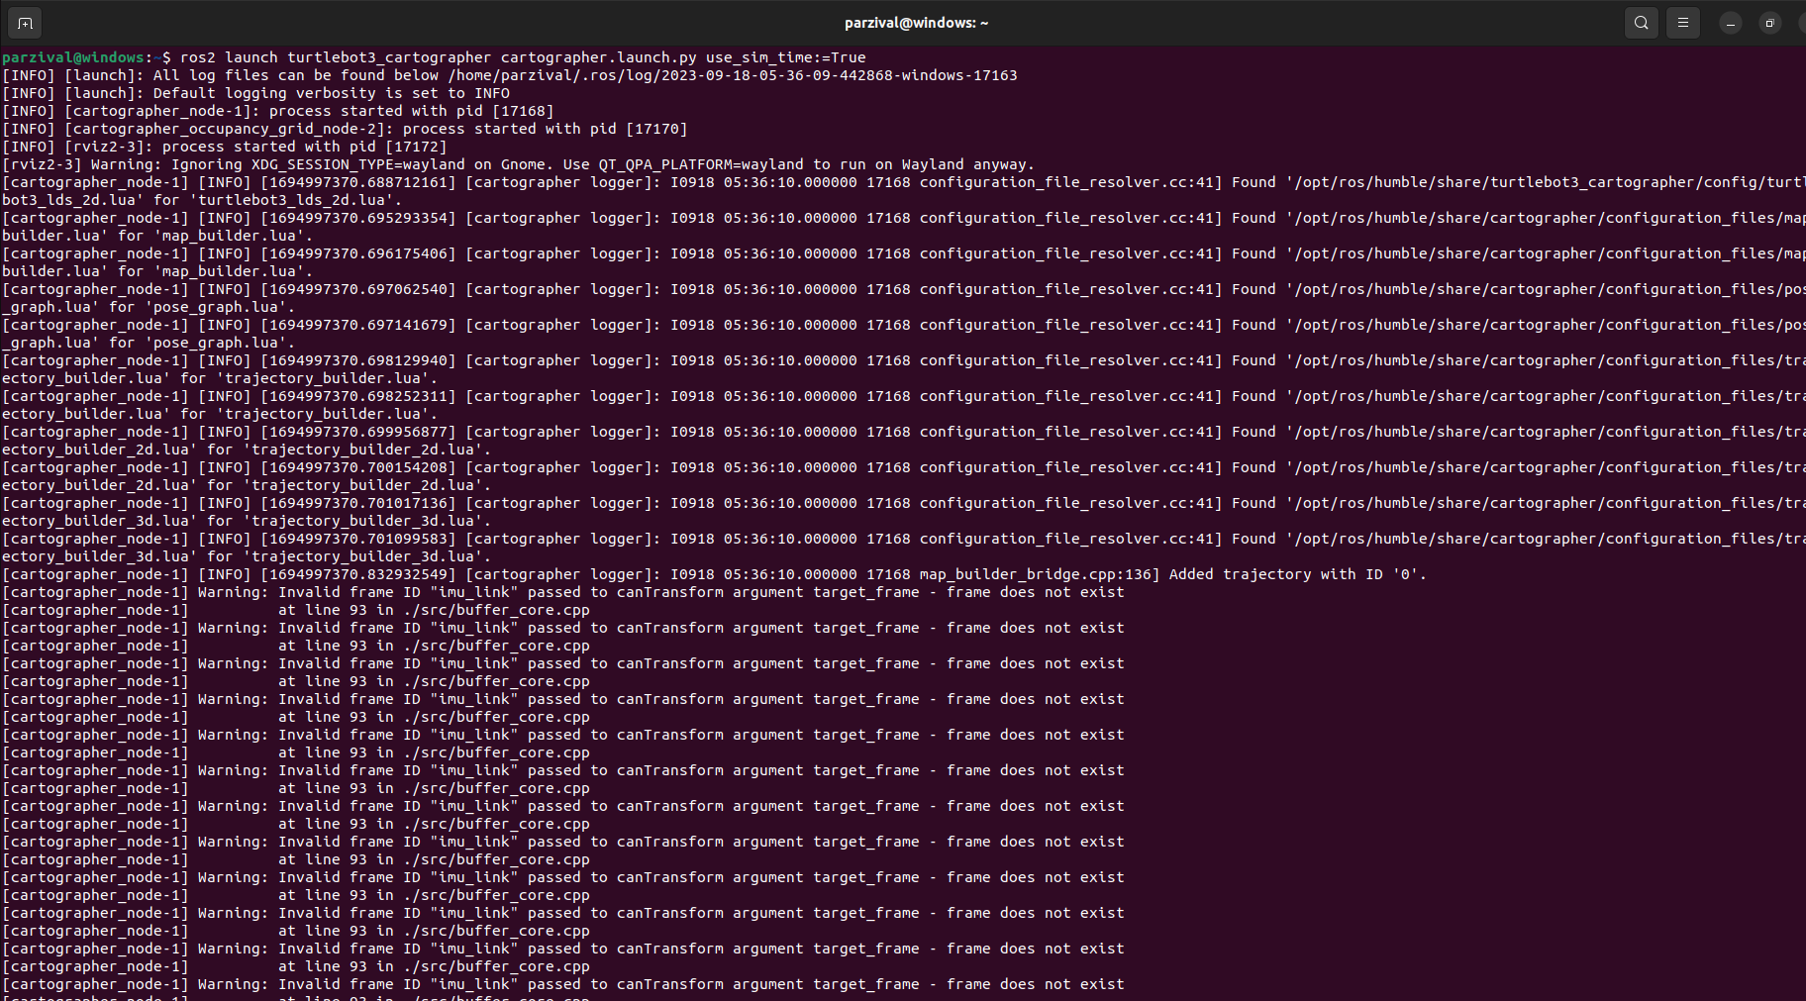
Cartographer Mapping: This command is used to launch the Cartographer package for mapping in ROS 2. Cartographer is a popular open-source system for simultaneous localization and mapping (SLAM) that allows robots to build maps of their environments as they navigate.
TurtleBot 3 Integration: The command specifies the turtlebot3_cartographer package, indicating that it is being used in conjunction with the TurtleBot 3 robot platform. TurtleBot 3 is a widely used ROS-based robot that's known for its versatility and educational applications.
Launch File: The cartographer.launch.py launch file is a Python-based configuration file that sets up and launches the Cartographer mapping system with the specific parameters and configurations needed for your TurtleBot 3. It defines how Cartographer interacts with sensors and how the mapping process is initiated.

Slide 23
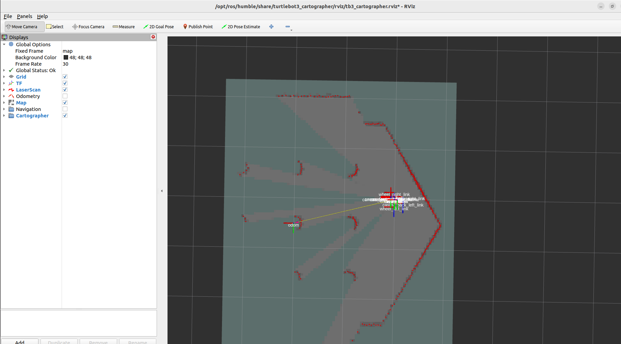
Map Visualization: RViz is a powerful visualization tool in ROS 2 that allows you to view and interact with various data, including maps generated by SLAM systems like Cartographer. The map displayed in RViz provides a visual representation of the environment that the robot has mapped.
Mapping Progress: RViz often displays the evolving map in real-time as the robot explores its surroundings and updates the map. This can be valuable for monitoring the mapping progress and ensuring that the robot is accurately perceiving and recording its environment.
Navigation and Planning: The map in RViz serves as a foundational component for robot navigation and path planning. It provides the robot with information about obstacles, free space, and other environmental features. This map data is used by navigation algorithms to plan safe and efficient paths for the robot to follow.

